Slide 1
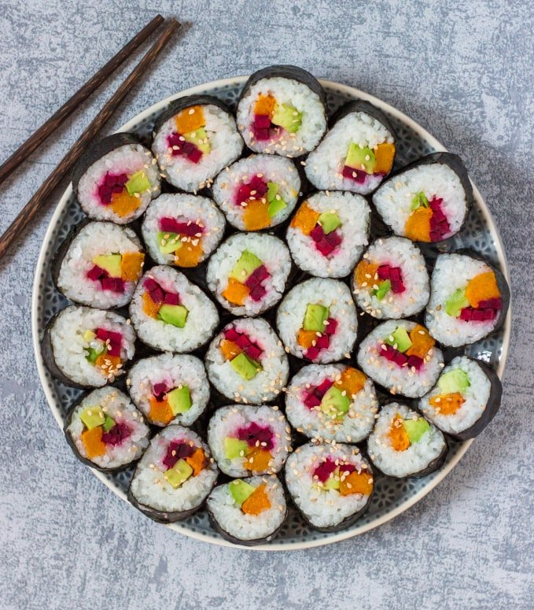
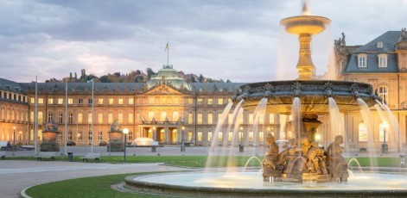
Sushi Restaurant
Promising Location for a new restaurant in Cologne

Slide 2
Approach
Generally, possible locations will be judged by competition and popular nearby leisure places.
Criteria for the competition are restaurant density, likes and ratings
The used data’s source is the Foursquare Database (from May 14 2020)

Slide 3
Raw Data
There are 48 entries for sushi restaurants in Cologne inside a 4 km radius
The 100 most popular leisure locations were exported from the DB
2 of the selected restaurants haven’t got rating data

Slide 4
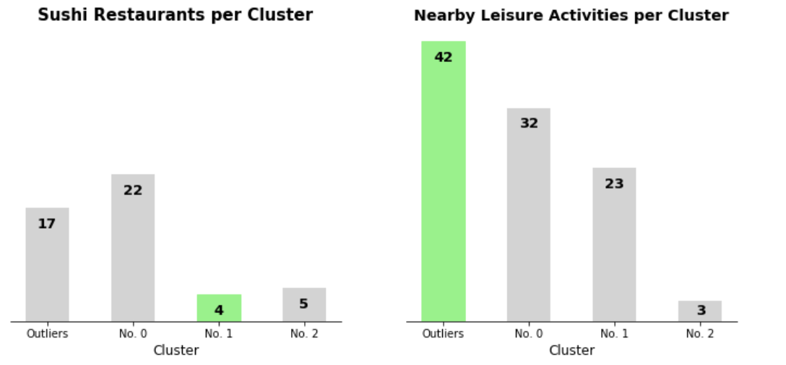
Restaurant Clusters
Main Insights:
DBSCAN-Algorithm found 3 Clusters + Outliers
Cluster 1 is the smallest cluster, only consisting of 4 competitors
Outliers have got the most leisure spots nearby followed by cluster 0 and cluster 1

Slide 5
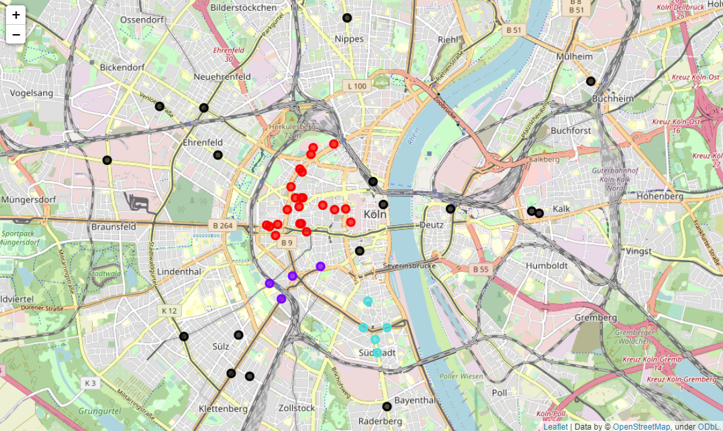
Cluster Locations
Outliers are fairly spread, giving the reason for the many popular places nearby
Cluster 0 is the city centre
Cluster 0
Cluster 1
Cluster 2
Outliers

Slide 6
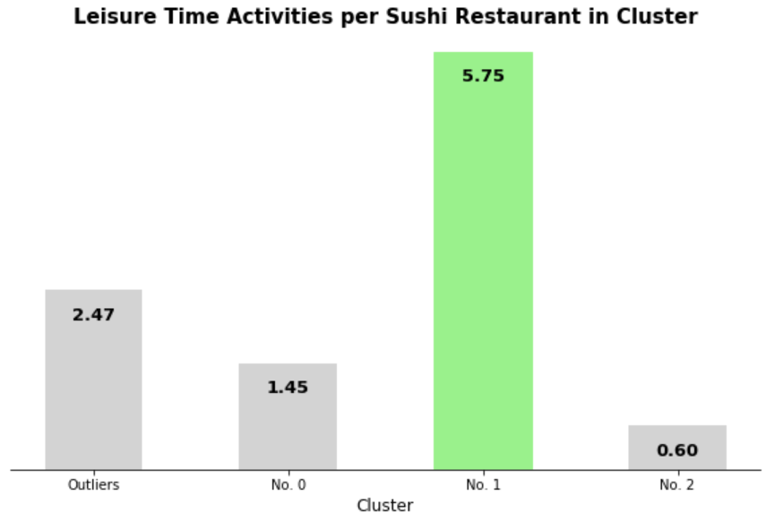
Popular Leisure Spot Rate
Cluster 1 has got the by far best restaurant/leisure spot-ratio

Slide 7
Competition Rating & Likes
Cluster 1 | Rating | Likes
MakiMaki Sushi Green | 7.5 | 14
Sushi Mii Bar Restaurant Köln | 5 | 2
Sushi Make | No data | 1
Sushi deLux | 7.7 | 8
Weak Competition
Cluster 2 | Rating | Likes
Sushi Teria | 7.6 | 12
Sushi Ninja | 8.1 | 31
MJ Sushi | 8.3 | 14
Sweet Sushi | 8.1 | 16
Akémi | No data | 6
Stronger Competition

Slide 8
Result
Cluster 1 – namely “Köln Süd” seems to be the best spot for a new sushi restaurant with a small and weak competition, while many popular places are nearby
If confrontation is not an option, a outlier spot near the city's centre can be considered. This might be a risky decision though, as the outlier spots near the centre are close to the hard-fought cluster 0
Additional research should include motion data, which isn’t publicly available for free with a sufficient quality

